Slide 1
A High-Speed Load-Balancer Design with Guaranteed Per-Connection-Consistency
Tom Barbette, Chen Tang, Haoran Yao, Dejan Kostić, Gerald Q. Maguire Jr.,
Panagiotis Papadimitratos, and Marco Chiesa, KTH Royal Institute of Technology
nsdi'20
黄家晏
2020/10/30
Notes:
高速负载均衡器设计，保证每个连接的一致性

Slide 2
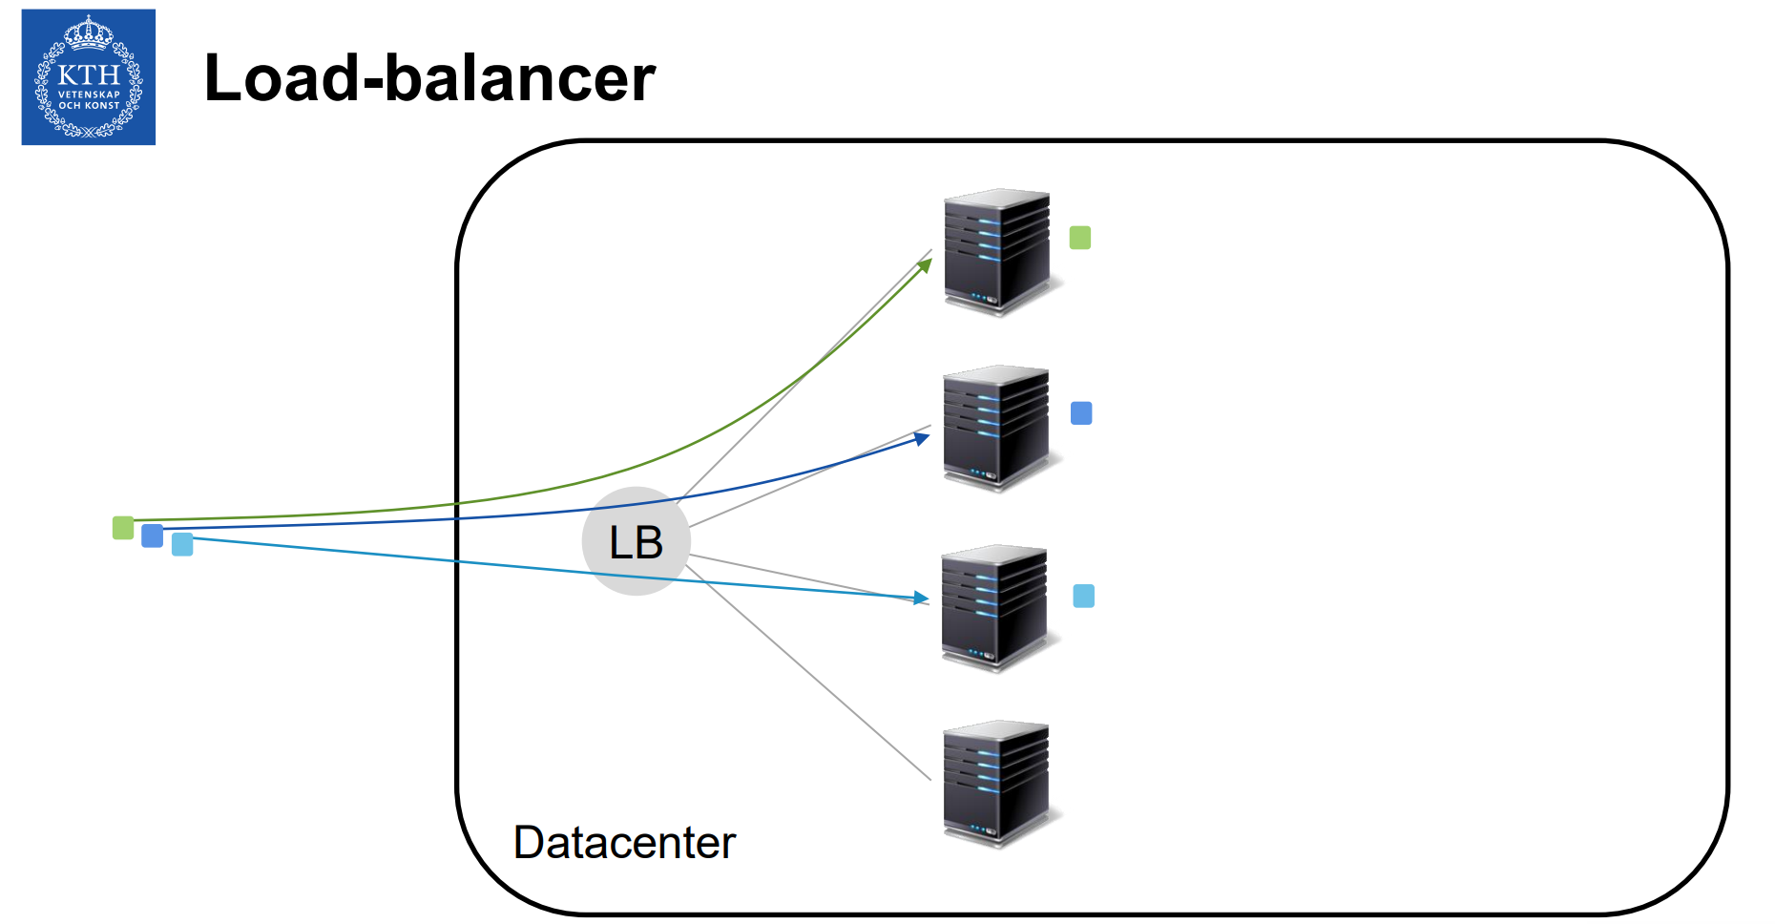
Challenges
Large service providers use load balancers to dispatch millions of incoming connections per second towards thousands of servers.
Two basic yet critical requirements for a load balancer:
uniform load distribution of the incoming connections across the servers
per-connection-consistency (PCC)
The challenge: Ensuring PCC
For each packet of an existing connection, the LB asks itself
Which server is handling this connection?
Today's solutions cannot ensure all requirements at the same times

Slide 3
Background
Datacenter operators assign a Virtual IP (VIP) address to each operated service.
Each VIP in a DC is associated with a set of servers providing that service.
Each server has a Direct IP (DIP) address that uniquely identifies the server within the DC.
A LB inside the DC is a device that receives incoming connections for a certain VIP and selects a server to provide the requested service.

Slide 4
CHEETAH
Which server is handling this connection?
CHEETAH: ask the user to remember for us
Key idea: store information about the load balancing decisions into a cookie
Properties:
dynamicity
per-connection-consistency
uniform load distribution
efficient packet processing
resilience

Slide 5
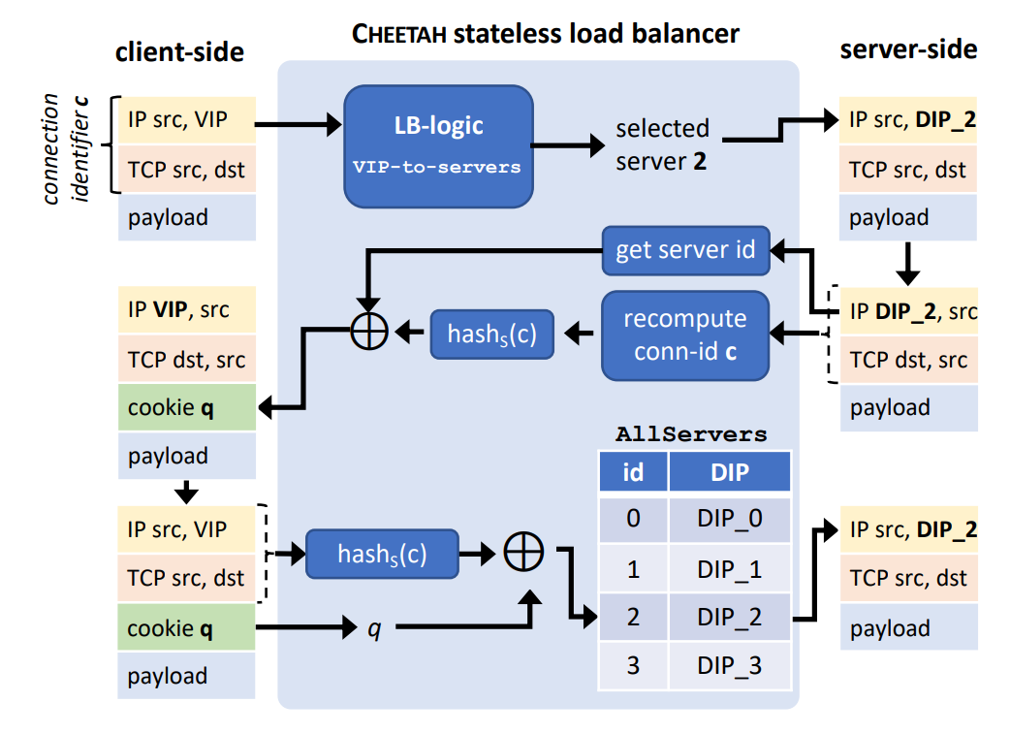
Stateless CHEETAH LB
Encoding an opaque offset into the cookie.
an AllServers table that maps a server identifier to the DIP of the server
a VIPToServers table that maps each VIP to the set of servers running that VIP.
Stateless CHEETAH guarantees PCC.
Stateless CHEETAH supports arbitrary load balancing mechanisms.

Slide 6
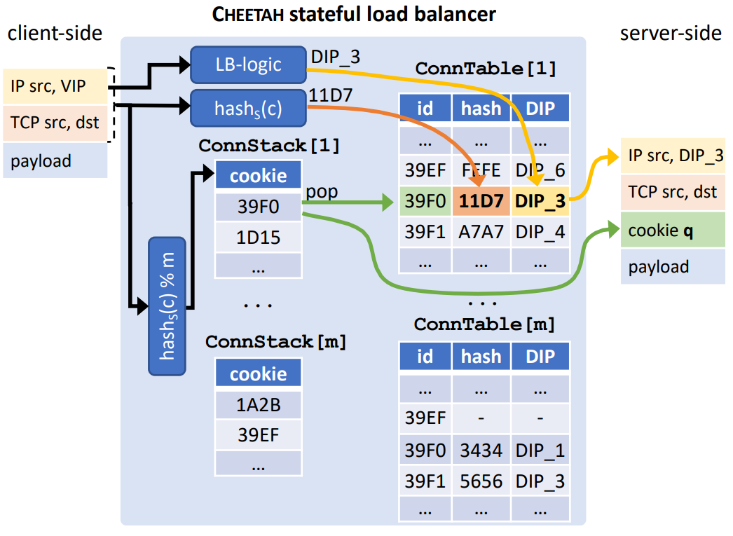
Stateful CHEETAH LB
support a finer level of visibility into the flows than that offered by stateless LBs.
A stateful LB can keep track of the behaviour of each individual connection and support complex network functions.
encoding table indices in the packet header.
store a set of m ConnTable tables that keep per-connection statistics and DIP mappings.
use an equal number of ConnStack stacks of indices, each storing the unused entries in its corresponding ConnTable.

Slide 7
Evaluation
Packet Processing Analysis
Load Imbalance Analysis
PCC Violations Analysis

Slide 8
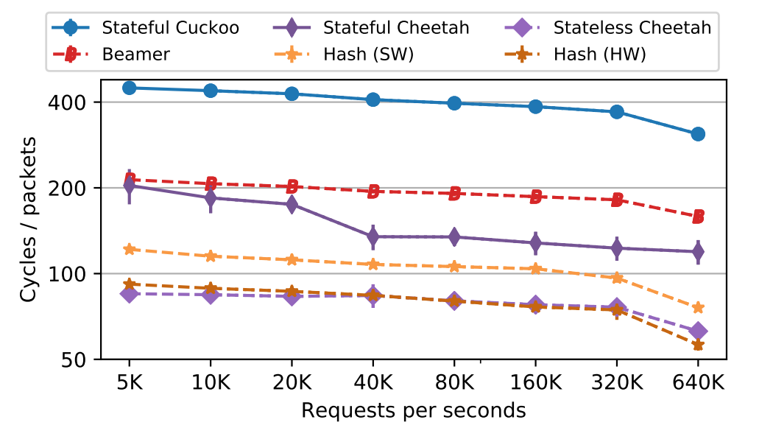
Evaluation
Packet Processing Analysis
Stateless CHEETAH incurs minimal packet processing costs.
Stateful CHEETAH outperforms cuckoo-hash based LBs.

Slide 9
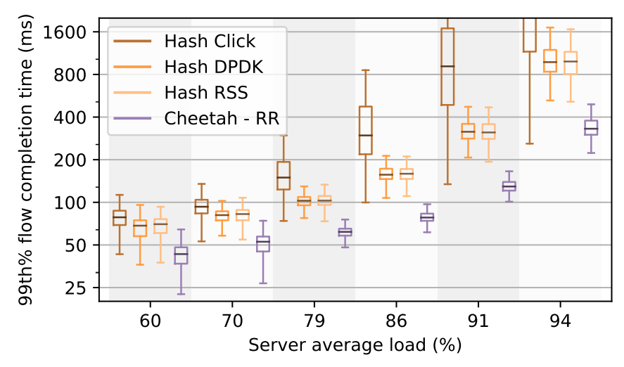
Evaluation
Load Imbalance Analysis
CHEETAH reduces the 99th percentile FCT by a factor of 2 − 3x compared to the best performing hash-based mechanism, i.e., Hash RSS.

Slide 10
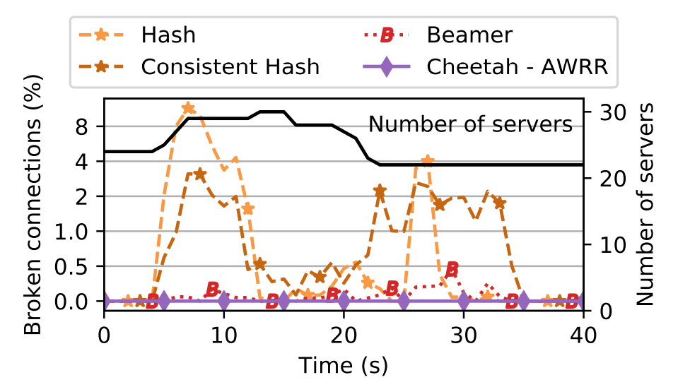
Evaluation
PCC Violations Analysis
Cheetah not only achieves better load balancing with AWRR, but it also does not break any connection.

Slide 11
Thanks

